Slide 1
Volume
A rectangular box is constructed from 10 square tiles, each of which has a perimeter of 24 centimeters. If the box is formed so that the tiles do not overlap, what is the volume of the box in cubic centimeters?

Slide 2
Volume
A rectangular box is constructed from 10 square tiles, each of which has a perimeter of 24 centimeters. If the box is formed so that the tiles do not overlap, what is the volume of the box in cubic centimeters?
2 tiles on top, 2 on bottom,
2 tiles on back and front
1 tile on both sides
Side of square: 6 cm (24/4)
Height: 6 cm
Length: 12 cm
Width: 6 cm
Volume: 12 x 6 x 6 = 432 cm³

Slide 3
Ratio
If X : Y = 5 : 6 and Y : Z = 7 : 2, find X : Z.

Slide 4
Ratio
If X : Y = 5 : 6 and Y : Z = 7 : 2, find X : Z.
X : Y = 5 : 6 = 35 : 42
Y : Z = 7 : 2 = 42 : 12
X : Y : Z = 35 : 42 : 12
X : Z = 35 : 12
LCM of 6 and 7 = 42

Slide 5
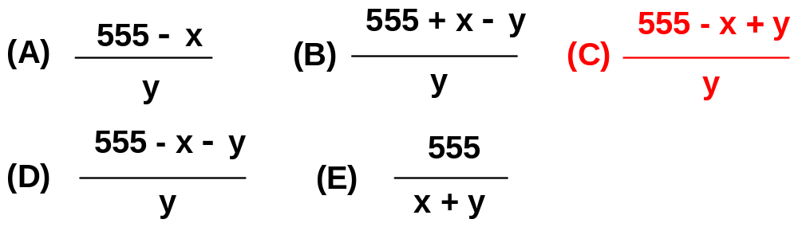
Ratio
A telephone company charges x cents for the first minute of a call and charges for additional time at the rate of y cents per minute. If a certain call costs $5.55 and lasts more than 1 minute, which of the following expressions represents the length of the call, in minutes?

Slide 6
Ratio
A telephone company charges x cents for the first minute of a call and charges for additional time at the rate of y cents per minute. If a certain call costs $5.55 and lasts more than 1 minute, which of the following expressions represents the length of the call, in minutes?
1st min: x (cents); the remaining min: (t − 1) y (cents)
x + (t − 1) y = 555 ($5.55 = 555 cents)
(t − 1)y = 555 − x
t − 1 = (555 − x)/y
t = (555 − x)y + 1 = (555 − x + y)/y

Slide 7
LCM: Least Common Multiple
What is the LCM of 1/3 and 2/5?

Slide 8
LCM: Least Common Multiple
What is the LCM of 1/3 and 2/5 LCM?
1/3, 2/3, 3/3, 4/3, 5/3, 6/3 = 2
2/5, 4/5, 6/5, 8/5, 10/5 = 2
2

Slide 9
LCM: Least Common Multiple
What is the LCM of 1/6 and 3/4?

Slide 10
LCM: Least Common Multiple
What is the LCM of 1/6 and 3/4?
1/6, 2/6, 3/6, 4/6, 5/6, 6/6, 7/6, 8/6, 9/6 = 3/2
¾, 6/4 = 3/2
3/2

Slide 11
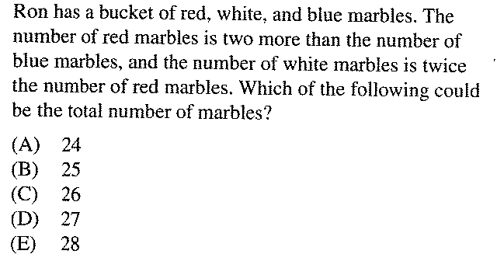

Slide 12
(C)
5 + 7 + 14 = 26

Slide 13
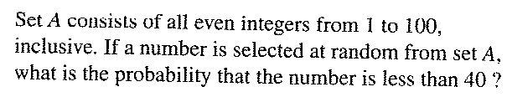

Slide 14
Even numbers less than 40: 19
Total even numbers: 50
Probability = 19/50

Slide 15
Fraction
On her biology test, Cathy answered 5/6 of the questions correctly. If Cathy answered 18 of the the first 27 questions correctly, what is the least number of questions on the test?

Slide 16
Fraction
On her biology test, Cathy answered 5/6 of the questions correctly. If Cathy answered 18 of the the first 27 questions correctly, what is the least number of questions on the test?
Cathy already missed 9 questions
Number of questions missed = 1/6 total number
1/6 total number ≥ 9
Total number ≥ 54

Slide 17
Fraction
Peter is taking a True/False test. He only got 3 of the first 11 questions correct. What is the minimum total number of questions the test must have on it for Peter to still have a chance at getting 3/4 of the questions correct?

Slide 18
Fraction
Peter is taking a True/False test. He only got 3 of the first 11 questions correct. What is the minimum total number of questions the test must have on it for Peter to still have a chance at getting 3/4 of the questions correct?
Peter already got 8 questions wrong, so incorrect questions ≥ 8
Incorrect questions = ¼ total number (3/4 correct)
¼ total number ≥ 8
Total number ≥ 32

Slide 19
Ratio
The ratio of Sally’s age to Lucy’s age is 8 : 5. 30 years later, this ratio will be 6 : 5. How much older is Sally than Lucy now?

Slide 20
Ratio
The ratio of Sally’s age to Lucy’s age is 8 : 5. 30 years later, this ratio will be 6 : 5. How much older is Sally than Lucy now?
Sally Lucy
Now 24 15
30 years later 54 45
Ratio in 30 years 6 : 5
Sally – Lucy = 9

Slide 21
Ratio
The ratio of Sally’s age to Lucy’s age is 8 : 5. 30 years later, this ratio will be 6 : 5. How much older is Sally than Lucy now?
Sally Lucy
Now 8x 5x
30 years later 8x + 30 5x + 30
Ratio in 30 years 6 : 5
(8x + 30)/(5x + 30) = 6/5
5 •(8x + 30) = 6 • (5x + 30)
40x + 150 = 30x + 180
10x = 30
X = 3
Sally − Lucy = 8x − 5x = 3x = 9

Slide 22
Ratio
Three boxes A, B and C, had 260 ping pong balls. Lisa added some ping pong balls into box A and the number of ping pong balls in box A tripled. She took out half of the ping pong balls in box B and added 40 ping pong balls into box C. The ratio of the number of ping pong balls in boxes A, B and C became 6 : 4 : 5. Find the original ratio of the number of ping pong balls in boxes A, B and C.

Slide 23
Ratio
Three boxes A, B and C, had 260 ping pong balls. Lisa added some ping pong balls into box A and the number of ping pong balls in box A tripled. She took out half of the ping pong balls in box B and added 40 ping pong balls into box C. The ratio of the number of ping pong balls in boxes A, B and C became 6 : 4 : 5. Find the original ratio of the number of ping pong balls in boxes A, B and C.
A B C
Current 6x 4x 5x
Original 2x 8x 5x − 40
The original total number is 260, so
2x + 8x + 5x − 40 = 260
15x = 300
X = 20
A : B : C = 2x : 8x : (5x − 40)
= 40 : 160 : 60 = 4 : 16 : 6 = 2 : 8 : 3

Slide 24
Percentage/Ratio
When siblings Mik, Ike and Spike do chores around the house their parents pay them each different amounts of money. Ike always gets 20% more money than Spike, while Ike always gets 30% less money than Mike. If their parents decide to pay them $13.70 total, how much does Ike get paid?

Slide 25
Percentage/Ratio
When siblings Mik, Ike and Spike do chores around the house their parents pay them each different amounts of money. Ike always gets 20% more money than Spike, while Ike always gets 30% less money than Mike. If their parents decide to pay them $13.70 total, how much does Ike get paid?
Ike : Spike = 120 : 100 = 6 : 5 (= 42 : 35)
Ike : Mike = 70 : 100 = 7 : 10 (= 42 : 60)
Ike : Spike : Mike = 42 : 35 : 60
= 42/137 : 35/137 : 60/137
= 30% : 26% : 44%
Ike = 42/137 •13.70 = $4.2
= 30% • 13.70 = $4.2

Slide 26
Ratio
A sum of money was shared between A, B and C so that A received ¼ of the sum, and the remainder was shared between B and C in the ratio of 3 : 2. Find the ratio in which the sum was shared between A, B and C.

Slide 27
Ratio
A sum of money was shared between A, B and C so that A received ¼ of the sum, and the remainder was shared between B and C in the ratio of 3 : 2. Find the ratio in which the sum was shared between A, B and C.
A : ¼ = 5/20
B: ¾ x 3/5 = 9/20
C: ¾ x 2/5 = 6/20
A : B : C = 5 : 9 : 6

Slide 28
Ratio
A job can be completed in 15 days by 9 men.
How long will it take 5 men to finish the job if
they work at the same rate?

Slide 29
Ratio
A job can be completed in 15 days by 9 men.
How long will it take 5 men to finish the job if
they work at the same rate?
9 men, 15 days
1 man, 9 x 15 days
5 men, (9 x 15)/5 = 27 days
Or 9 x 15 (man-days) = 5 ● x (man-days)
X = 27 days

Slide 30
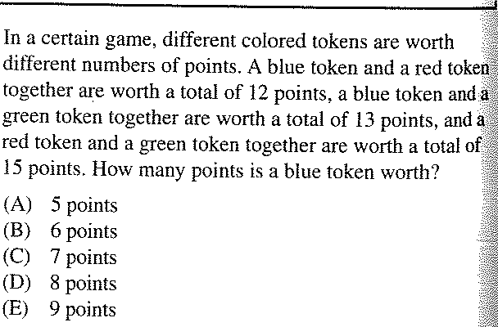

Slide 31
B + R = 12
B + G = 13
R + G = 15
B = ?
2B + 2G + 2R = 40
B + G + R = 20
B + 15 = 20
B = 5 (A)

